Slide 1
Carbon disulfide
Robert Hendrickson, MD

Slide 2

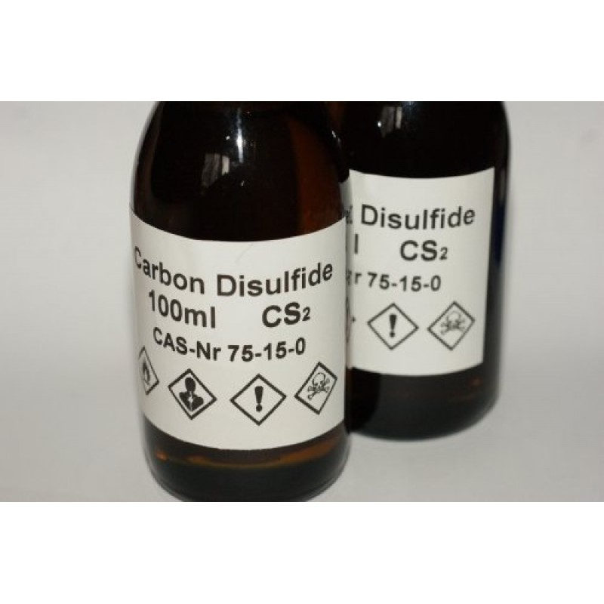
Carbon disulfide
CS₂
Production – worldwide
  2 CH₄ + S₈ → 2 CS₂ + 4 H₂S
    Natural gas
    Silica gel/alumina catalysts
Notes:
Technical grade – sweet smell

Slide 3
Carbon disulfide
Carbon disulfide –
  Colorless / yellow
  Volatile
    Vapor accumulates along the ground

Slide 4
Carbon disulfide
Uses:
  Viscose rayon production
  Cellulose production
  Building block for
    Fungicides/soil fumigants
    Xanthates (used in mining)
    Accelerators (for rubber vulcanization)
    Pharmaceuticals
    Carbon tetrachloride
  Solvent

Slide 5



Viscous Rayon
“Artificial silk”
“Art silk”
Woven & knitted
Easily dyed

Slide 6
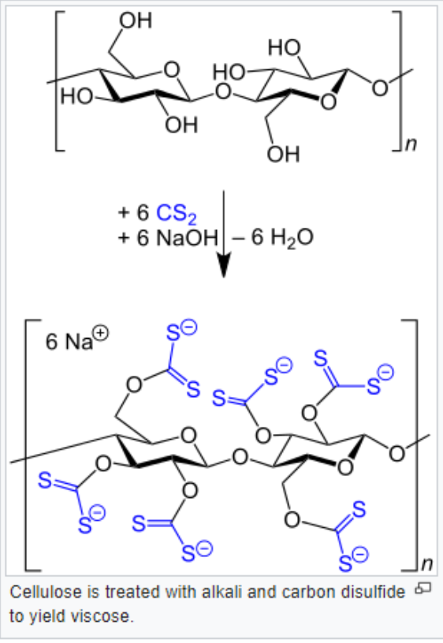
Viscous Rayon
Cellulosic fiber
  Similar to cotton (but polymer length is shorter)
Produced using cellulose:
  Wood pulp
  Bamboo
  Sugar cane
Add sodium hydroxide (alkali cellulose)
Add carbon disulfide (sodium cellulose xanthate)
    Xanthate = ROCS₂⁻ Na⁺

Slide 7
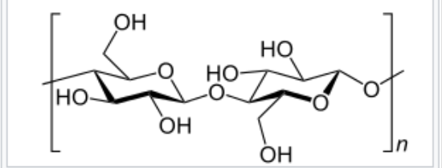
Viscous Rayon
Sodium cellulose xanthate
  Ripening (polymerization)
Extrude through sulfuric acid
  Yields rayon
    Pure cellulose

Slide 8
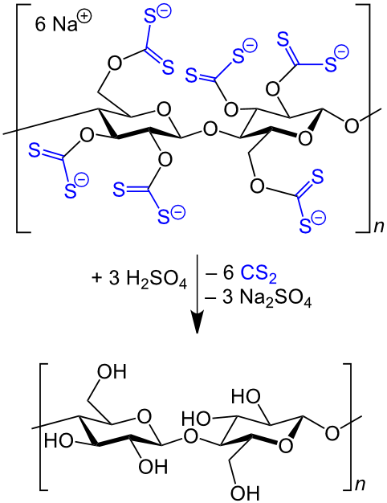
Viscous Rayon

Slide 9
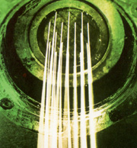
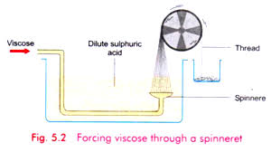
Viscous Rayon
Extruded through spinnerets
Notes:
Each thread = 0.1mm

Slide 10
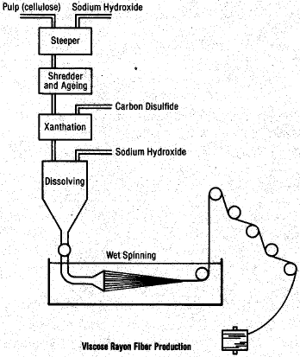
Viscous Rayon

Slide 11
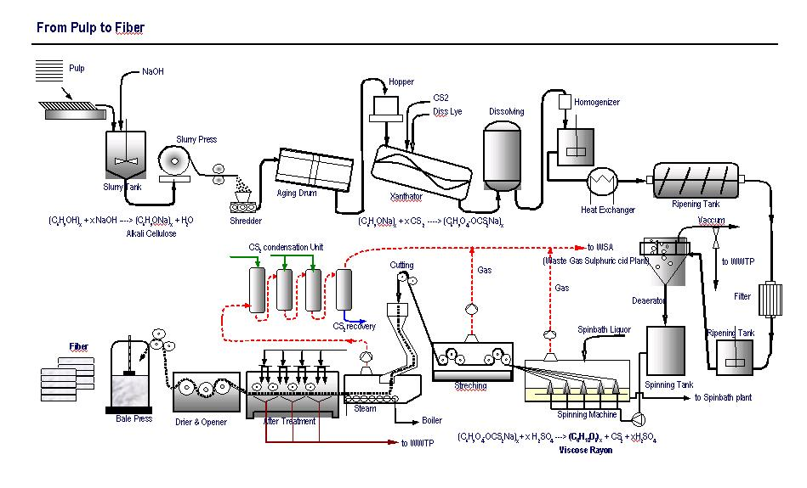
Viscous Rayon

Slide 12
Carbon disulfide
Exposure:
  Inhalational
  Dermal
Environmental – small amounts
  Volcanic eruptions
  Marshes

Slide 13
Carbon disulfide
Toxicity – acute exposure (accident)
  Pulmonary/mucosal irritant
  CNS depression
    Kamat SR. Chem Engin World 1994; 29: 107-111

Slide 14
Carbon disulfide
Toxicity – chronic exposure
  Accelerated atherogenesis, CAD, angina, MI
  233 exposed VR worker & 174 non-exposed
  Control=561 deaths of local men w/o exposure
  Also looked at CV death rate of workers by their jobs within the factory who had > 10 years
Notes:
233 workers worked in the process where CS2 was used. 174 worked at the company, but not in processing and were not exposed.

Slide 15
% of deaths from CVD:
  42% rayon process workers
  24% other rayon workers
  17% local males

Slide 16
Carbon disulfide
Notes:
233 workers worked in the process where CS2 was used. 174 worked at the company, but not in processing and were not exposed.

Slide 17
Carbon disulfide
Toxicity – chronic exposure
  Accelerated atherogenesis, CAD, angina, MI
    Balcarova O, Halik J. 1991. Sci Total Environ 101(l-2): 97-99.
    Hernberg S, Nordman CH, Partanen T, et al. 1971. Work Environ Health 8:11-16.
    Hernberg S, Nurminen M, Tolonen M. 1973. Work Environ Health 10:93-99.
    Nurminen N, Mutanen P, Tolonen H, et al. 1982. Am J Epidemiol 115: 107-l18.
    Sugimoto K, Goto S, Kanda S, et al. 1978. Stand J Work Environ Health 4:151-158.
    Tiller JR, Schilling RS, Morris JM. 1968. Br Med J 4:407-411.
    Tolonen M, Nurminen M, Hernberg S. 1979. Stand J Work Environ Health 5:109-114.
  Increased total & LDL cholesterol
  Decreased fibrolytic activity

Slide 18
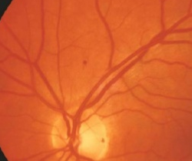
Carbon disulfide
Toxicity – chronic exposure
  Retinal toxicity
    Retinal microaneurysm
    20-25% of workers v 4-8% of controls (Japanese & US, but NOT in Finnish workers)
      NIOSH. 1984a. NTIS/PB85-110229.
      Raitta C, Tolonen M. 1975. Arch Klin Exp Ophthalmol 195:149-54.
      Sugimoto K, Goto S, Kanda S, et al. 1978. Stand J Work Environ Health 4:151-158.
      Sugimoto K, Goto S, Taniguchi H, et al. 1977. Int Arch Occup Environ Health 39:97-101.
      Tolonen M, Hernberg S, Nordman CH, et al. 1976. Int Arch Occup Environ Health 37:249-264.
    Delayed choroidal filling (due to rigid retinal arteries)
Notes:
Workers were exposed to 15-35 ppm during the 1950s & 5-15ppm after.

Slide 19
Carbon disulfide
Toxicity – chronic exposure
  Neuropathy
    Dose related reduction in motor nerve conduction in workers exposed to CS2
      Johnson
      Rujen 90,93
      Sikora 90
  Tremor, parkinsonism
  Cerebral atrophy
    Aaserud 88
  Cognitive/neuropsychological – mixed studies
Notes:
Workers were exposed to 15-35 ppm during the 1950s & 5-15ppm after.

Slide 20
Carbon disulfide
Disulfiram reactions:
  CS2 inhibits aldehyde dehydrogenase slightly
  Unlikely – at 80mg/dL ETOH & 10ppm CS2
    Freundt KJ, Lieberwirth K, Netz H, et al. 1976. Int Arch Occup Environ Health 37:35-46.
Notes:
Workers were exposed to 15-35 ppm during the 1950s & 5-15ppm after.

Slide 21
Carbon disulfide

Slide 22
Global Harmonized System of Classification and Labeling of Chemicals (GHS)
Labeling:
  Identification of product
  Signal word: Danger or Warning
  Hazard and precautionary statements
  Identity of the supplier

Slide 23
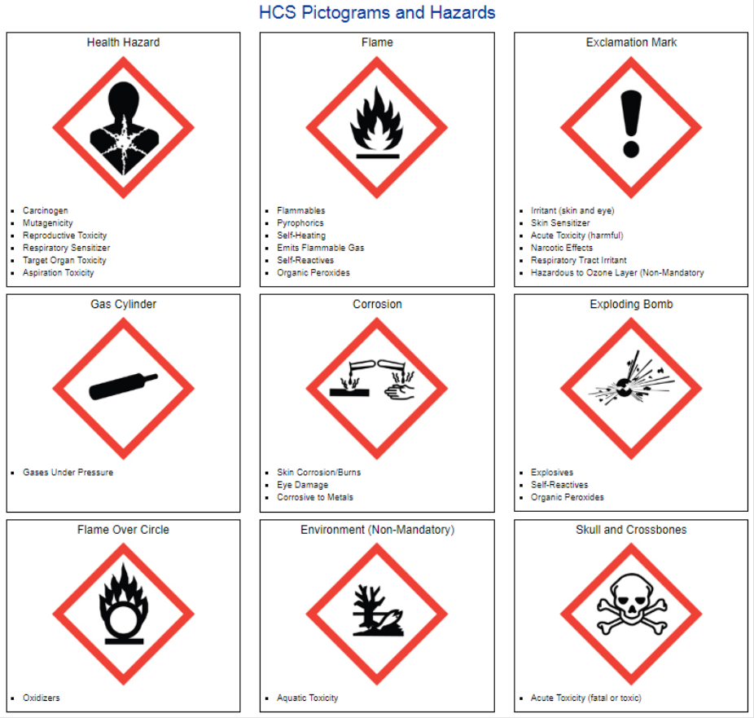
Global Harmonized System of Classification and Labeling of Chemicals (GHS)

Slide 24
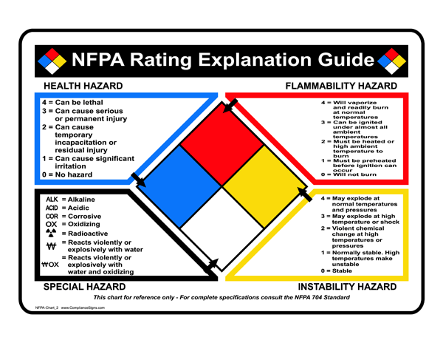
National Fire Protection Association (NFPA)

Slide 25
Carbon disulfide
Flammable
“Acute toxicity”
Organ toxicity
3: can cause serious or permanent injury
4: vaporize/burn at normal temp
0: Stable
No “special hazard”

Slide 26
For more information
https://www.atsdr.cdc.gov/toxprofiles/tp.asp?id=474&tid=84

Slide 27


Questions and discussion…

